Slide 1
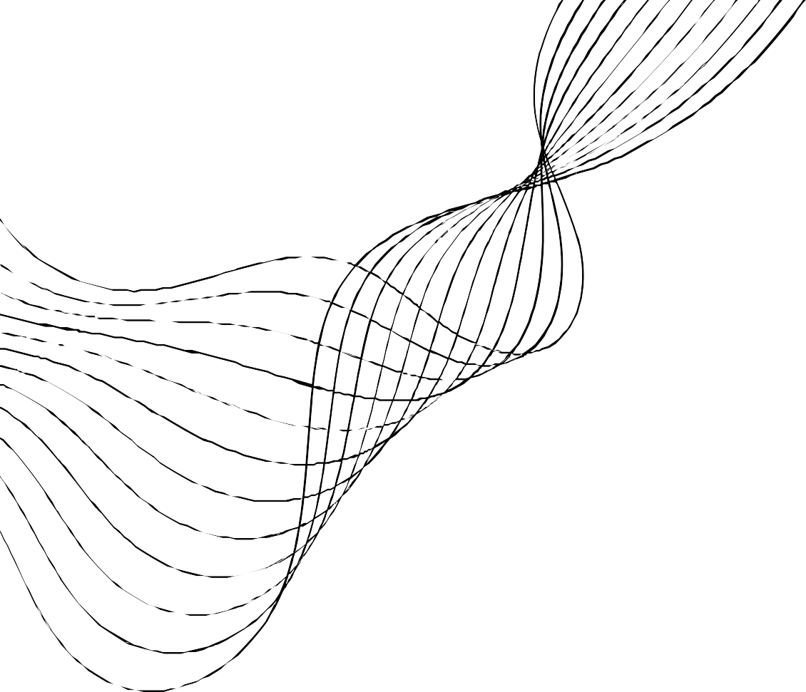


Handicraft
HANDICRAFT

Slide 2


CONTENT
01
PURPOSE
02
PRODUCT SCOPE
PRODUCT PERSPECTIVE PRODUCT FUNCTION
03
04
05
USER CLASSES AND CHARACTERISTICS
06
CONSTRAINS
USER INTERFACE
07
08
ER DIAGRAM
09
10
USE CASE DIAGRAM
USE CASE SCENARIO

Slide 3
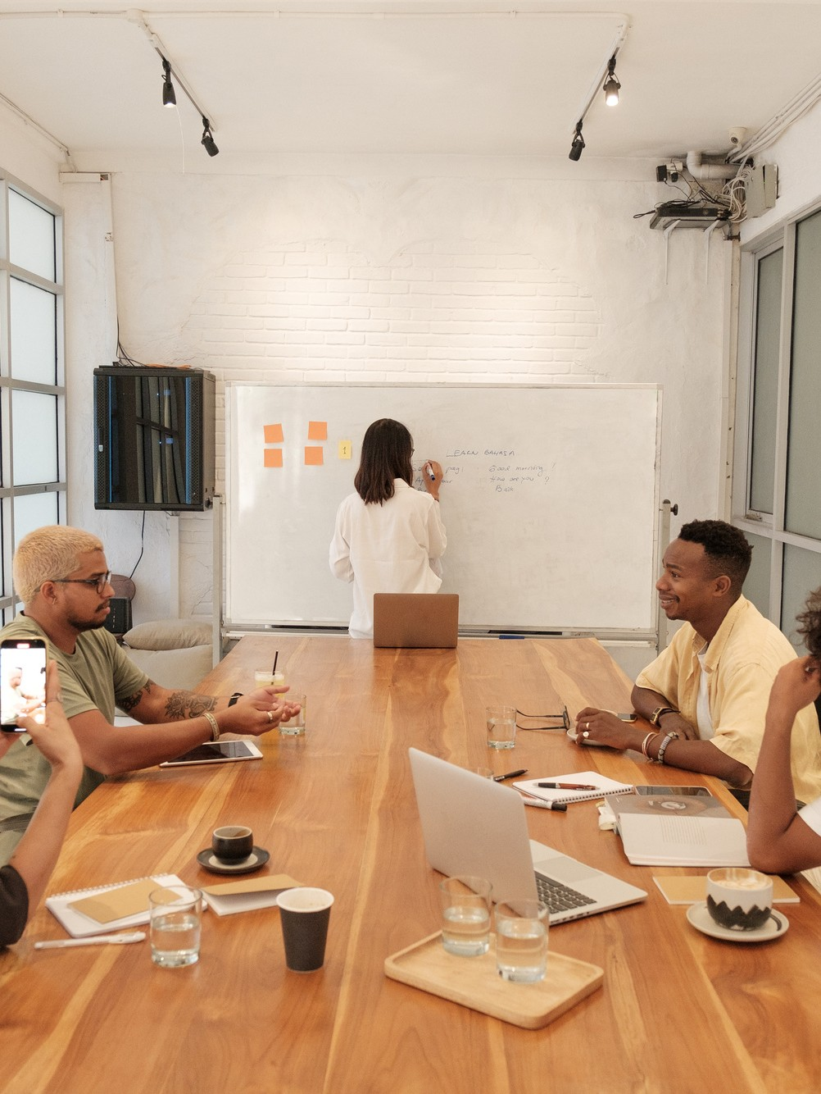


PURPOSE
Facilitate the process of buying and selling
Creating job opportunities for small enterprises
Providing online workshops
Helping hobbyists to start their own business
Creating job opportunities

Slide 4

PRODUCT SCOPE
- This site will provide most of the services related to handicrafts in terms of displaying handmade
products, buying and selling these products, and holding workshops to teach how these products work and conducting training courses.
- Security, ease of use and most importantly efficiency are some of the benefits/ features that the development team will offer with this system.
- The site will be comprehensively managed by the owner in terms of products reservation and ensuring their availability and delivery to the customer correctly.
- The team can access all system functions with l imited restrictions and view the owner' s views.
- Trainers can communicate with users ( trainees).
- Participating members can display all their products on our website and set the required price.

Slide 5



PRODUCT PERSPECTIVE
This Product was established for a number of reasons, the most important of which is to teach those interested in
handicrafts by craftsman, and also this platform focuses on displaying and selling goods, as well as teaching those
interested in how these accessories are made, also on this platform there are raw materials used in industry.

Slide 6

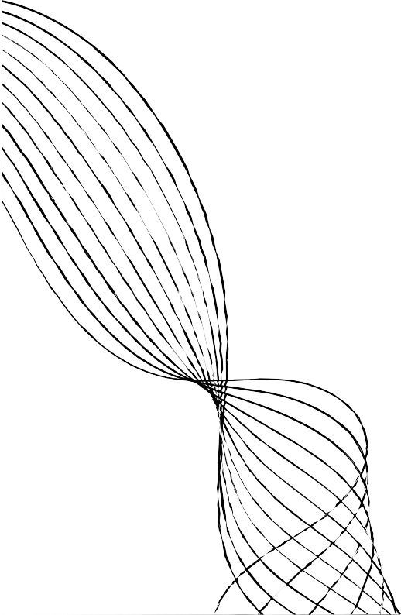
PRODUCT FUNCTION
Product Search
Find a video tutorial
Add a product
Browse products
Purchase a product
Purchase of tools
Setting prices
Educational workshops

Slide 7
USER CLASSES AND CHARACTERISTICS
He is the content
creator and also, he is the one who teaches people interested in
this f ield, and also this manufacturer can offer his products for sale
and how to make them.
CRAFTSMAN
A person who offers products for sale and
this person may be the one who made the
product himself or he may have bought it and f lew from it and then
offered it for sale, or he may have bought the product after it was
completely
manufactured and then offered for sale.
SALES REPRESENTATIVE
The main factor
influencing this project can make or break this project. The user is not l imited to buying
products, he can also offer some of his
products for purchase, and he can also help in the f ield of education by publishing some
useful educational videos that he had
previously learned from.
THE USER

Slide 8



CONSTRAINS
We can create this project as an application, but due to the short time, we will only do it as a website on the browser.
The system will require a minimum of 256MB memory, and 1 GB memory is recommended.
When designing system interfaces, we had the ability to work with new and modern tools, but due to the f inancial
circumstances, we decided to work with what was available.

Slide 9

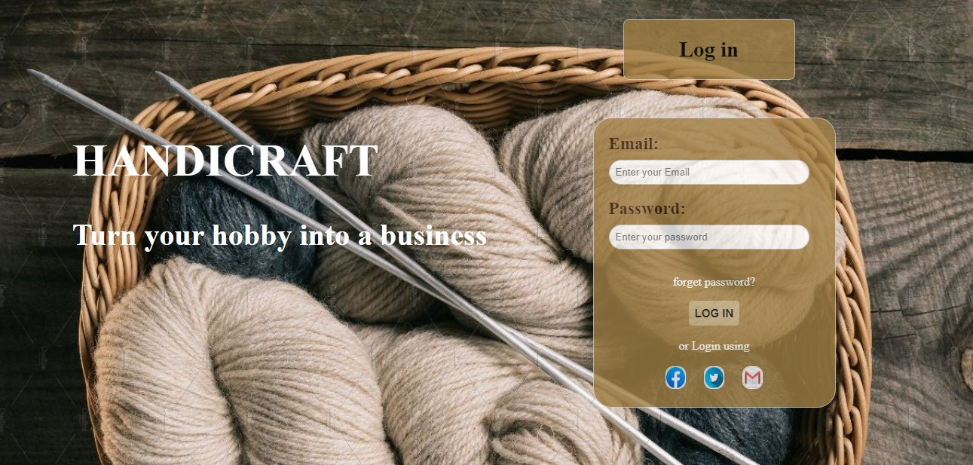
USER INTERFACE
FIG 1 : LOG IN

Slide 10
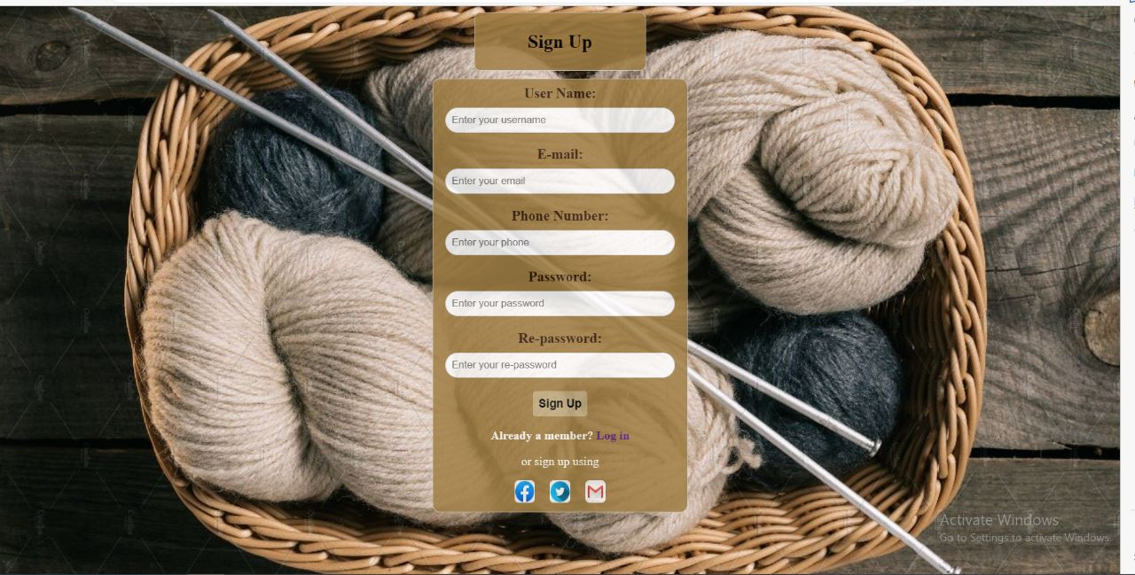
USER INTERFACE
FIG 2 : SIGN UP

Slide 11


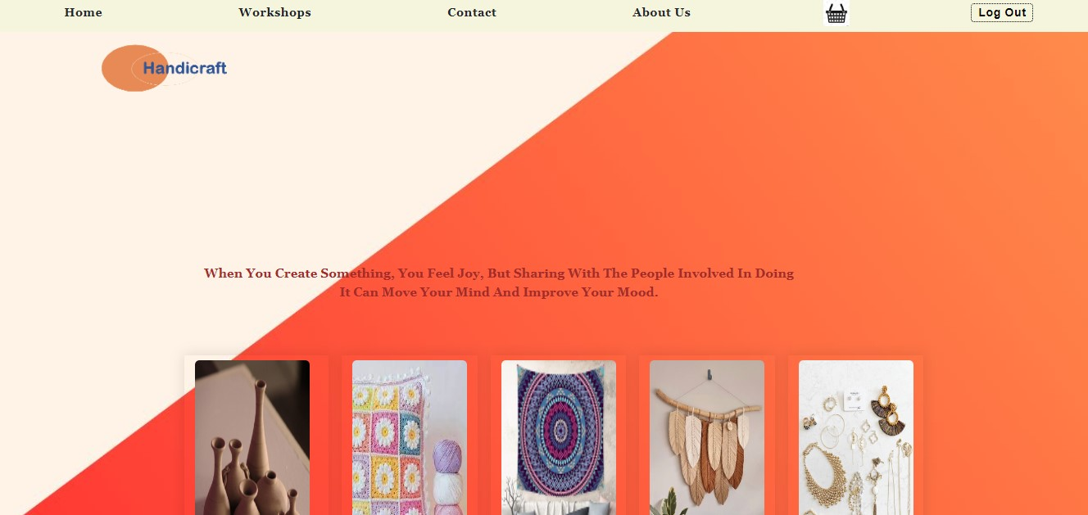
USER INTERFACE
FIG 3 : HOME PAGE CUSTOMER

Slide 12
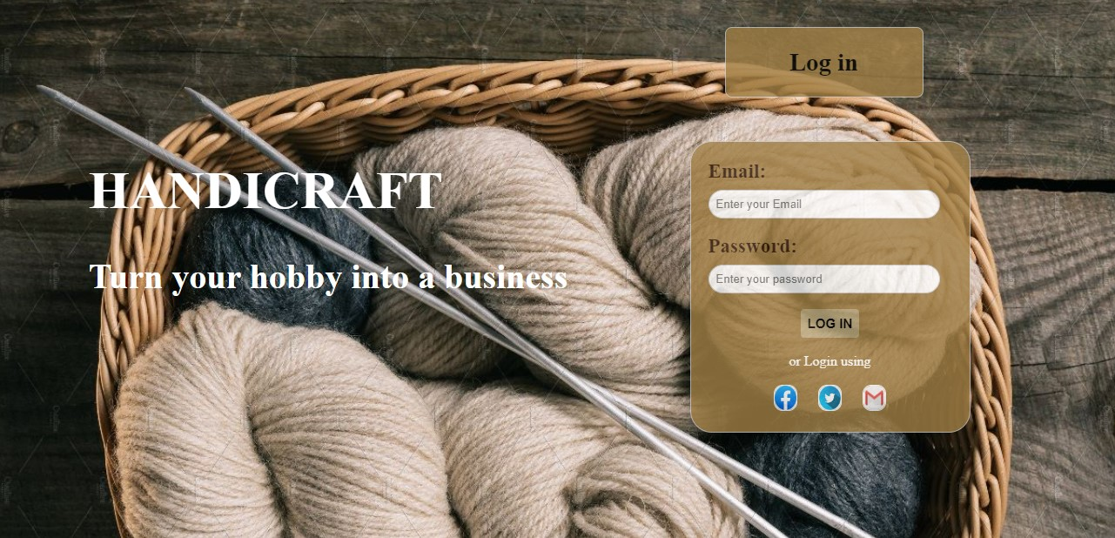
F
USER INTERFACE
FIG 4: ADMIN_LOG IN

Slide 13
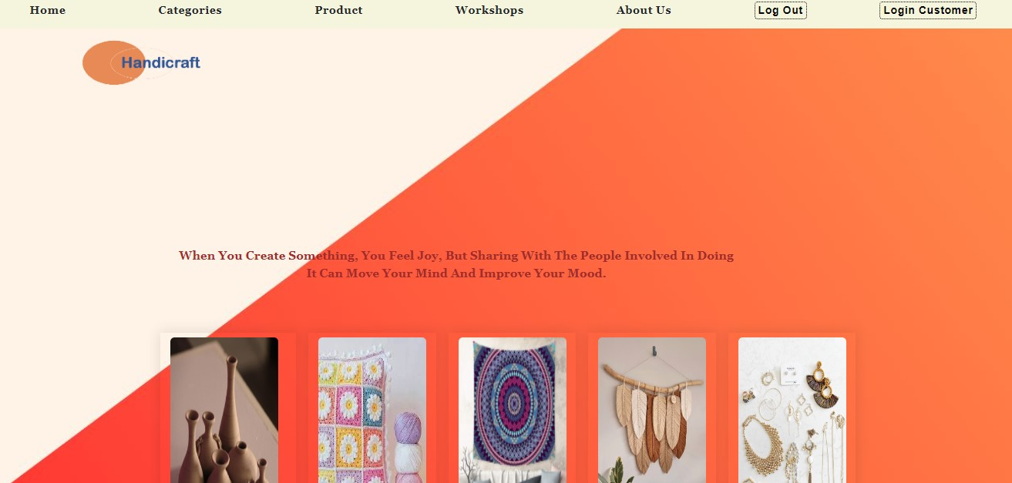
USER INTERFACE
FIG 5: ADMIN_HOME

Slide 14
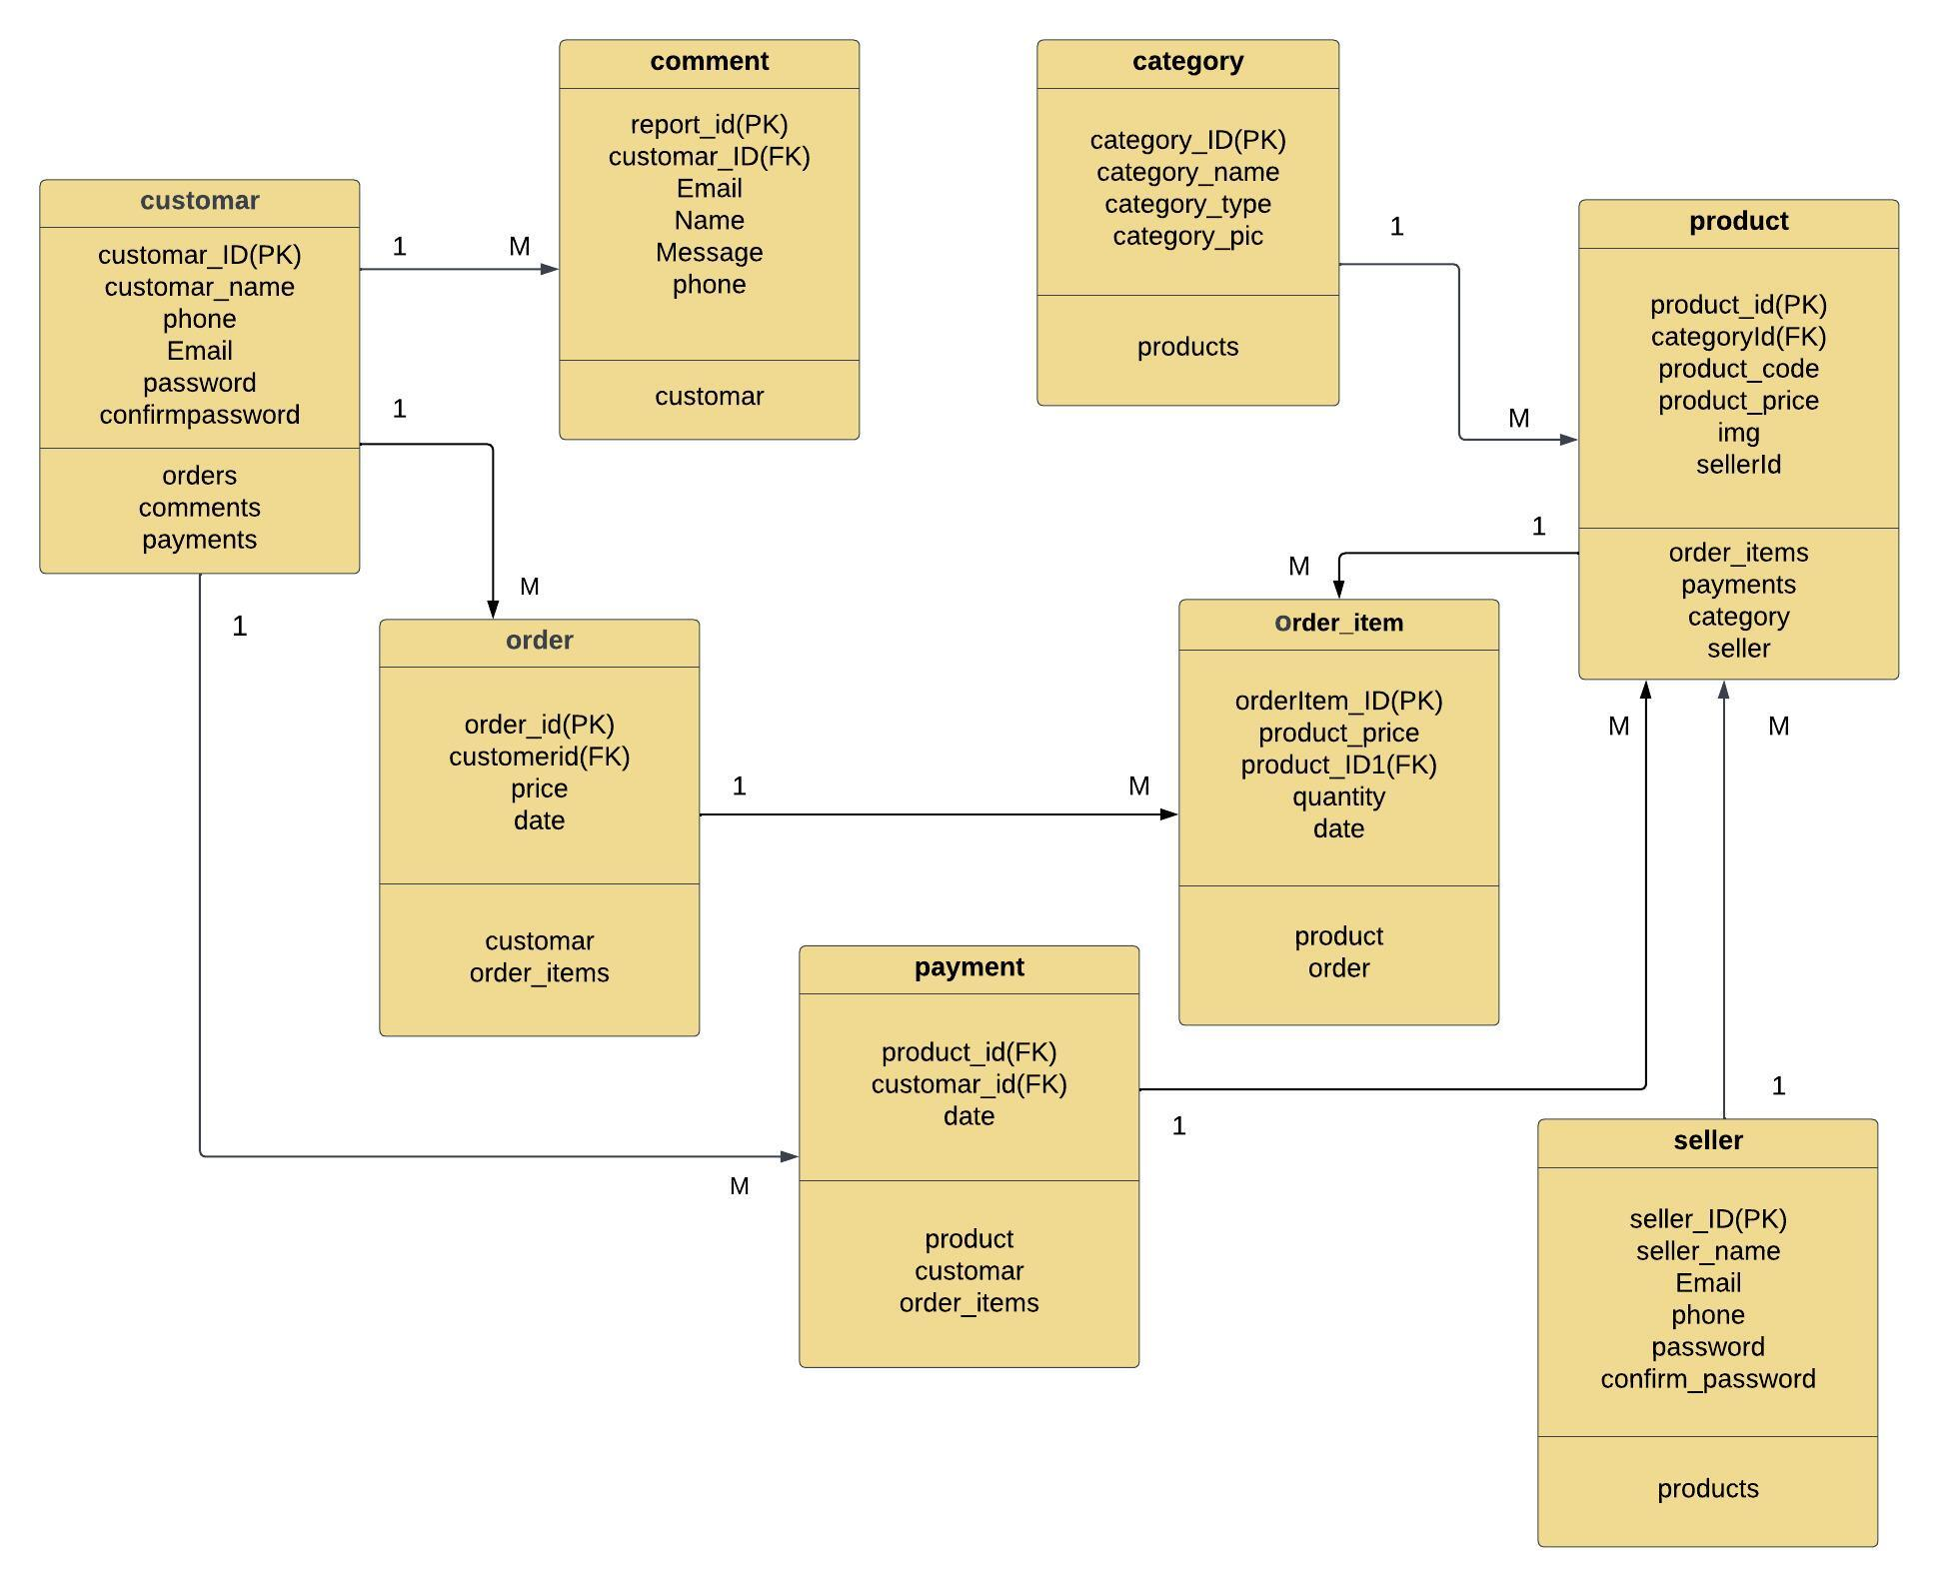
ERD DIAGRAM

Slide 15
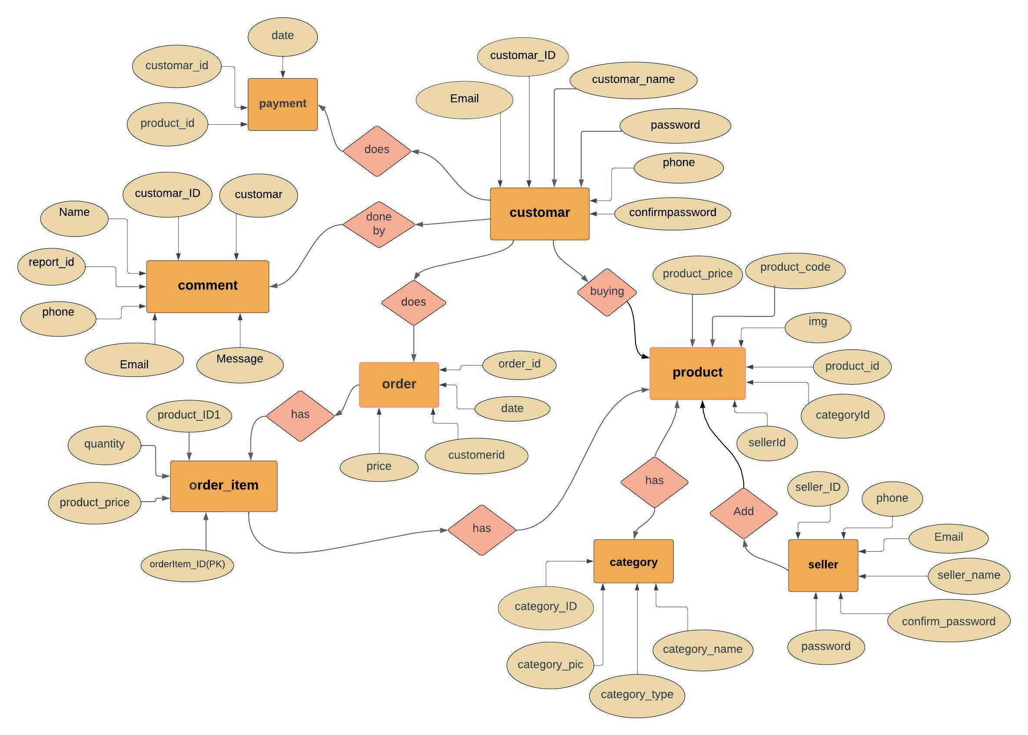
USE CASE DIAGRAM

Slide 16
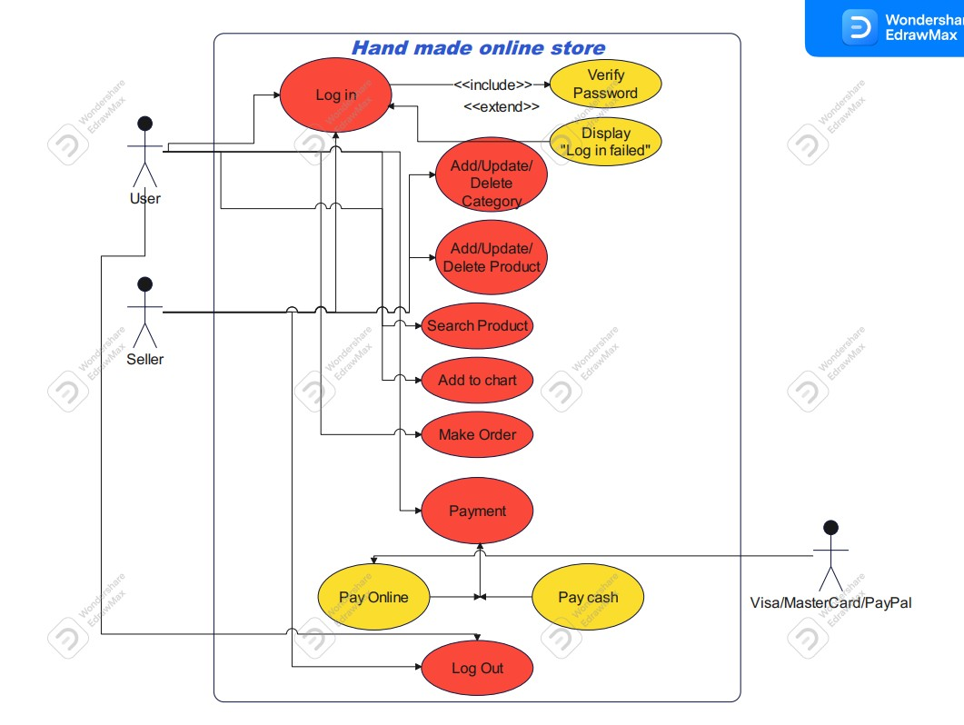
USE CASE SCENARIO

Slide 17


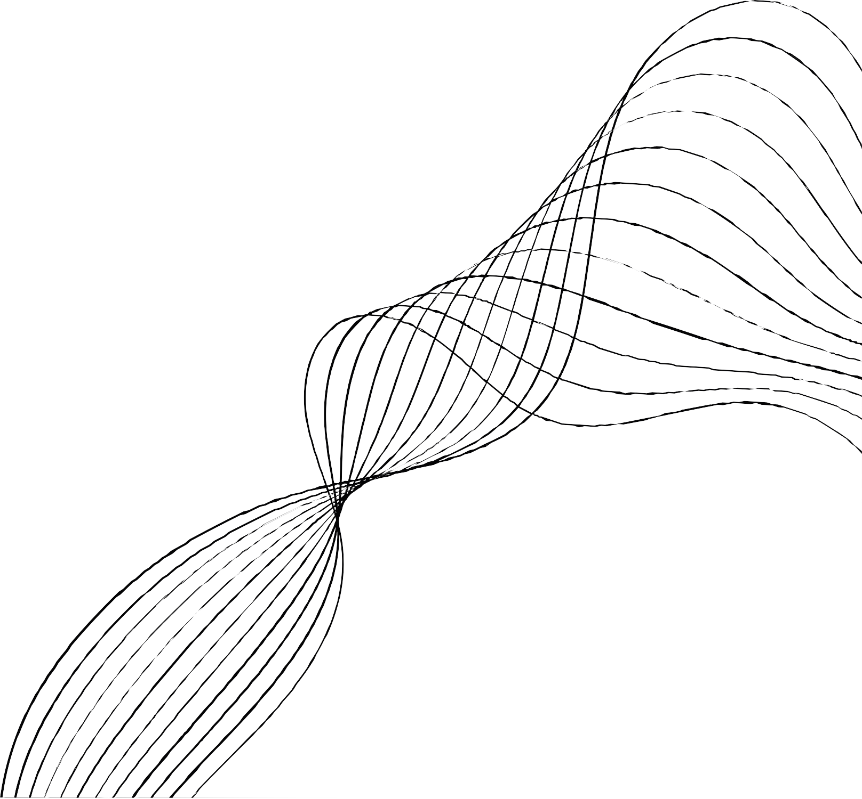

OUR TEAM
Rola Alaa
Designer
Rahil Rafat
Programmer
Ziad Walid
Designer
Dina Ahmed
Designer
Aya Ahmed
Programmer
Doaa Ahmed
Programmer
Ziad Mohamed
Designer

Slide 18



Handicraft
THANK' S FOR WATCHING

